Slide 1
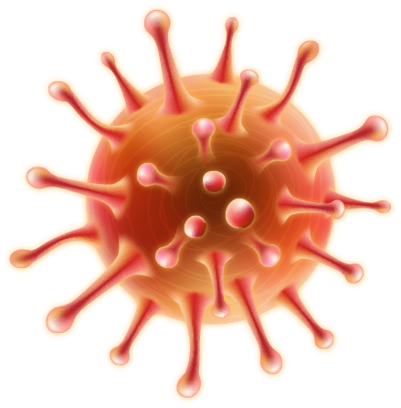
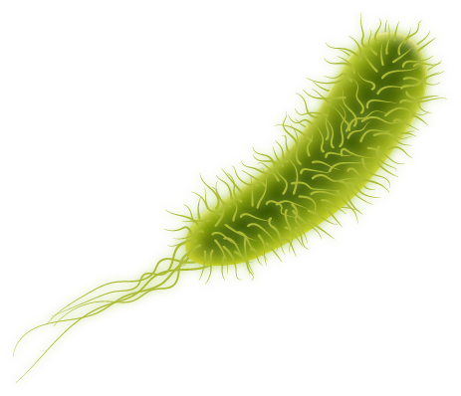
THE VIRUSES
REPORTER 2
GRANADEROS DIANE C.

Slide 2
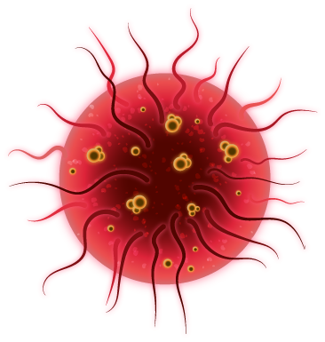
INTRODUCTION
Viruses are typically described as obligate intracellular parasites, acellular infectious agents that require the presence of a host cell in order to multiply.
It can infect all types of cells – humans, animals, plants, bacteria, yeast, archaea, protozoa.
Require a host cell for replication.
A complete virus, with all the components needed for host cell infection, is referred to as a virion.
.
Viruses are typically described as obligate intracellular parasites, acellular infectious agents that require the presence of a host cell in order to multiply.
It can infect all types of cells – humans, animals, plants, bacteria, yeast, archaea, protozoa.
Require a host cell for replication.
A complete virus, with all the components needed for host cell infection, is referred to as a virion.
.

Slide 3
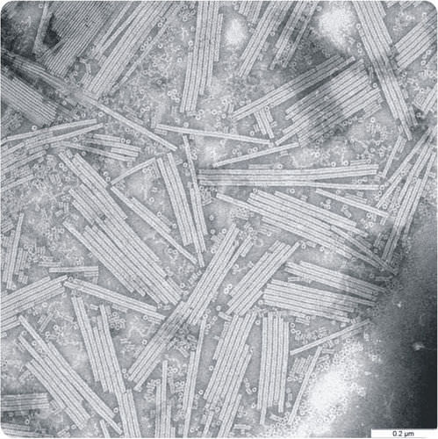
INTRODUCTION
Tobacco mosaic virus was the first virus to be discovered.

Slide 4
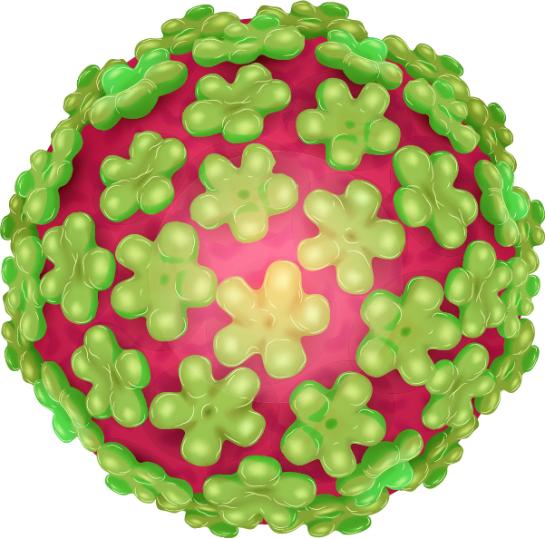
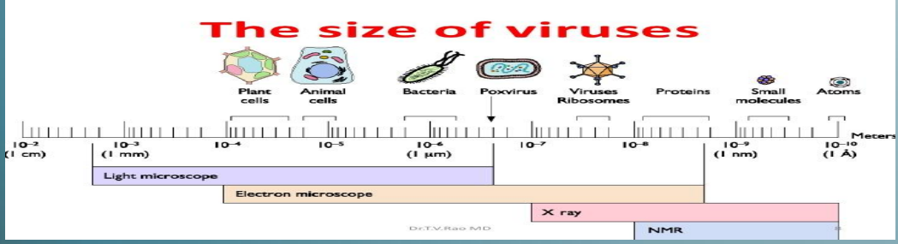
GENERAL CHARACTERISTICS
Most viruses range in sizes from 20 – 250 nm

Slide 5
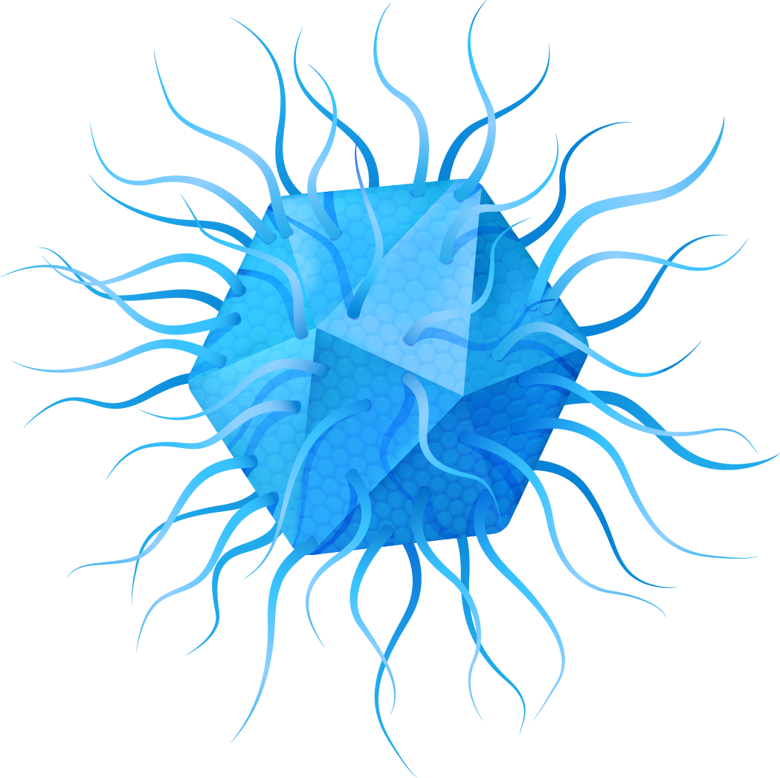
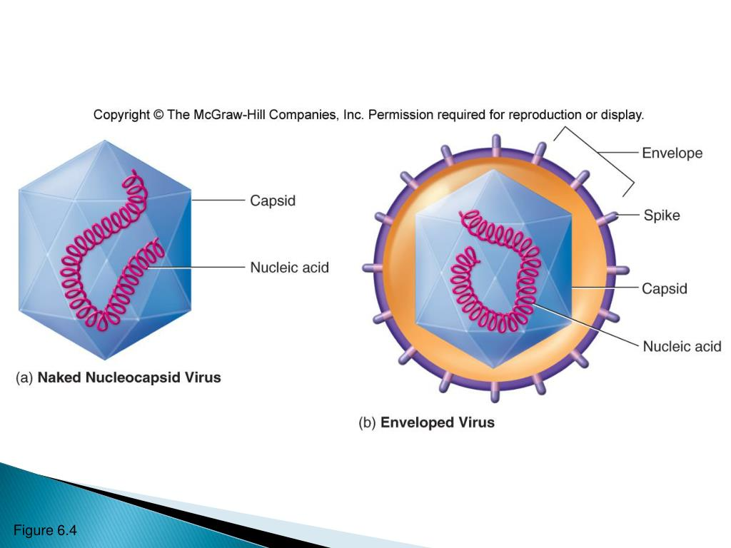
GENERAL CHARACTERISTICS
Extracellular
VIRION
Isn’t capable of reproducing.
It consist of nucleic acid surrounded by a protein coat known as a capsid.
Nucleic acid core contains the genetic materials.
Envelope outer lipid membrane derived from the host cell membrane.
Viruses that has envelope is called ENVELOPE VIRUSES (ex. Herpes, HIV)
Viruses that lack envelope is called NAKED VIRUSES (ex. Polioviruses)

Slide 6

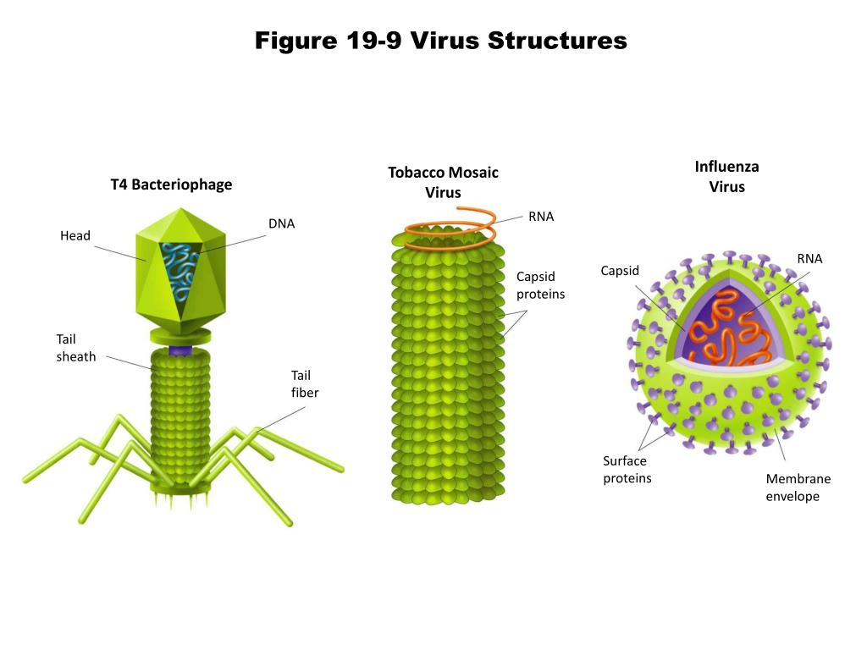
Three Types of Capsid Symmetry
Helical
Capsid
Icosahedral
Capsid
Complex
Capsid

Slide 7
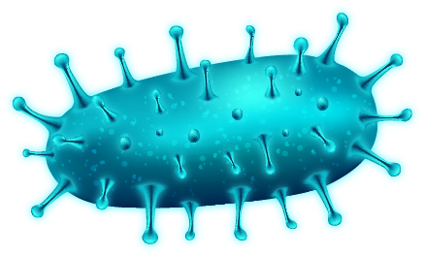
Intracellular
GENERAL CHARACTERISTICS
Virus Replication Cycle
1. Attachment
2. Penetration or Viral Entry
3. Synthesis
4. Assembly
5. Release

Slide 8
Intracellular
GENERAL CHARACTERISTICS
Virus Replication Cycle
1. Attachment
2. Penetration or Viral Entry
3. Synthesis
4. Assembly
5. Release

Slide 9
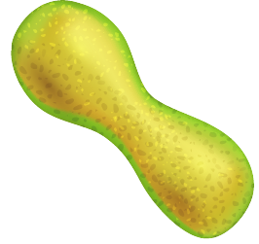
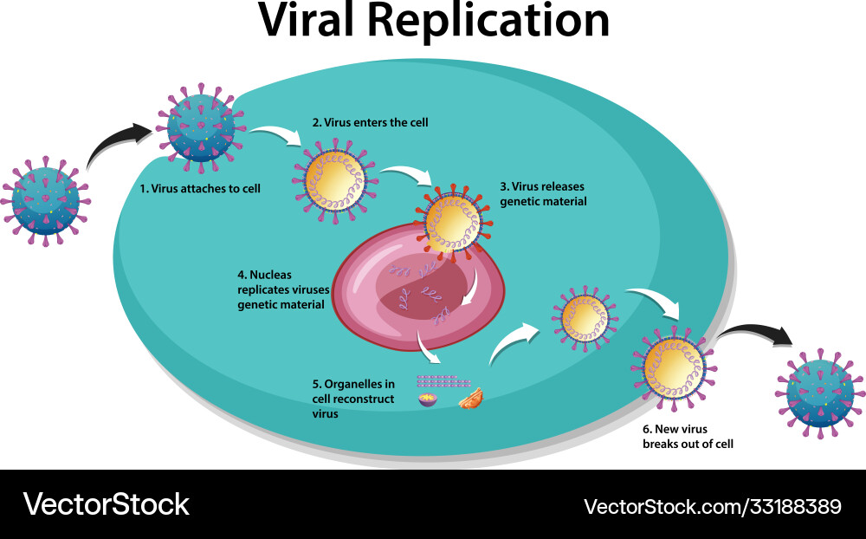
Virus Replication Cycle
1. Attachment
The attachment itself is highly specific, between molecules on the outside of the virus and receptors on the host cell surface. This accounts for the specificity of viruses to only infect particular cell types or particular hosts.

Slide 10
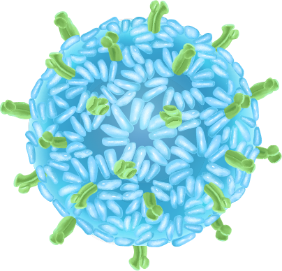
Virus Replication Cycle
2. Penetration or Viral Entry
Viruses inject their nucleic acid into the host cell
Direct Injection: Certain viruses, like bacteriophages, inject their genetic material directly into the host cell, leaving the viral capsid (protein coat) outside.
Endocytosis: The host cell engulfs the virus in a vesicle (a small bubble-like structure), bringing it inside the cell.
Membrane Fusion: Some enveloped viruses (e.g., HIV) fuse their membrane with the host cell membrane, allowing the viral genetic material to enter directly.

Slide 11
Virus Replication Cycle
3. Synthesis
Once inside the host cell, the viral genome (DNA or RNA) is released from the capsid. This step can occur in the cytoplasm or in a specific location like the nucleus, depending on the type of virus. It exposes the viral genome, allowing it to be replicated and transcribed.

Slide 12
Virus Replication Cycle
4. Assembly
New viral particles are assembled from the replicated viral genomes and synthesized viral proteins. The viral components (capsid proteins, enzymes, and nucleic acids) come together to form complete, infectious virions (virus particles).

Slide 13
Virus Replication Cycle
3. Release
The majority of viruses lyse (Lytic cycle) their host cell at the end of replication, allowing all the newly formed virions to be released to the environment.
Budding, where one virus is released from the cell at a time.

Slide 14
Virus of Bacteria

Slide 15
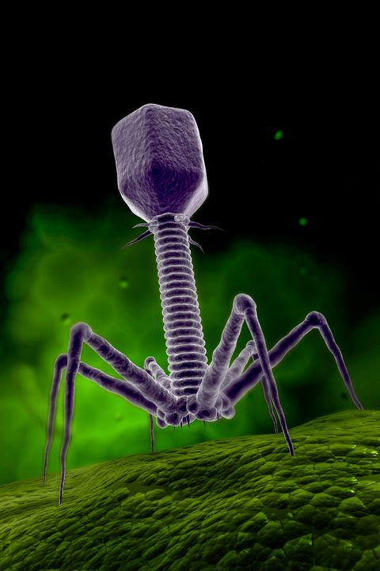
Bacteriophage
Bacteriophage, a group of viruses that infect bacteria. Bacteriophages were discovered independently by Frederick W. Twort in Great Britain (1915) and Félix d’Hérelle in France (1917).
D’Hérelle coined the term bacteriophage, meaning “bacteria eater,” to describe the agent’s bactericidal ability.

Slide 16
Structure of Bacteriophage
The basic structure of all bacteriophages is the same. They consist of a core of nuclear material surrounded by a protein capsid.
The genetic material or nuclear material of bacteriophages can be either DNA or RNA, both of which can either be double-stranded or single-stranded.
Bacteriophages are obligate intracellular parasites that remain latent outside the host cell and require host cellular machinery to conduct their metabolic activities.

Slide 17
Life Cycles of Bacteriophage
Lytic Cycle
The lytic cycle is one of the two lifecycles of bacteriophages where the viral DNA remains as a free-floating molecule and replicates separately from the bacterial DNA.
The lytic cycle usually occurs in virulent phages as the phages result in the destruction of the infected cell membrane during the release of the viral particles.
The lytic cycle is a virulent infection as it results in the destruction of a cell.

Slide 18
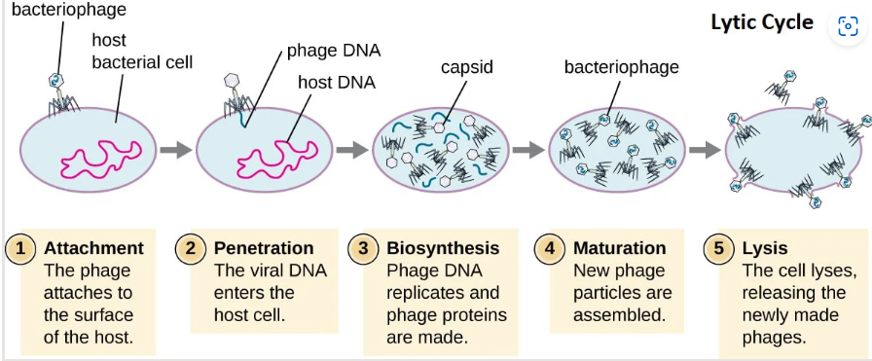
Life Cycles of Bacteriophage
Lytic Cycle

Slide 19
Life Cycles of Bacteriophage
Lysogenic Cycle
Lysogenic is one of the two lifecycles of bacteriophages defined by the incorporation of the bacteriophage genome into the host genome.
During the lysogenic lifecycle, the host bacteria continue to live and reproduce normally after the replication of bacteriophages.
The genetic material of bacteriophage incorporated in the bacterial DNA during the lysogenic lifecycle is called a prophage which can be transmitted to daughter cells during the bacterial cell division.
The lysogenic cycle is a temperate and non-virulent infection as the bacteriophage doesn’t kill the host cell.

Slide 20
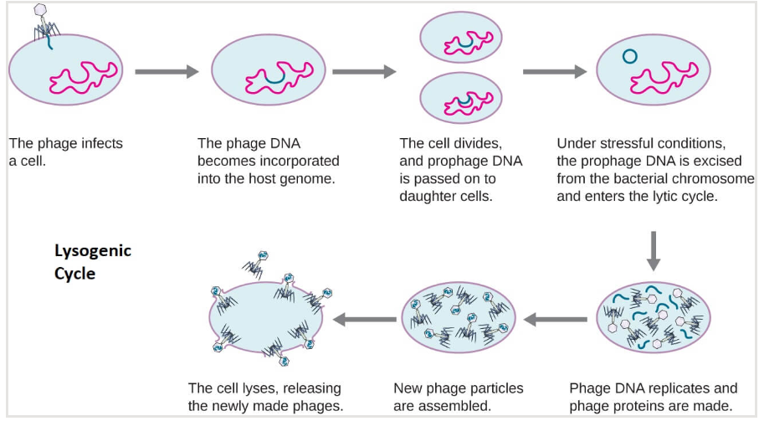
Life Cycles of Bacteriophage
Lysogenic Cycle

Slide 21
THANK YOU !

